Slide 1
ROUGH SET THEORY-
FUNDAMENTALS
Jaya Sil
Department of Computer Science and Technology
Indian Institute of Engineering Science and Technology, Shibpur
Howrah-711103
js@cs.iiests.ac.in

Slide 2
Motivation
Data Availability:
Wide availability of huge amount of data.
Need to be turned into useful information and knowledge.
Gained knowledge applied in business management, market analysis, engineering design, science exploration etc.

Slide 3
Data collection and database creation is the prerequisite for Data mining
Data management includes data storage, retrieval and database transaction processing
Data analysis and understanding involves data mining

Slide 4
What is data mining?
The process of discovering interesting knowledge from large amounts of data.
Data mining often used as a synonym for Knowledge Discovery in Database, but it is an essential step in the entire process which uncover hidden patterns for evaluation.

Slide 5
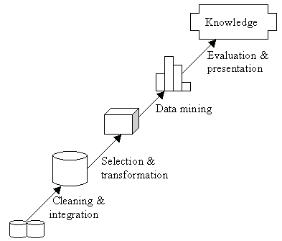
Knowledge Discovery in Database

Slide 6
Rough set theory
The notion of rough sets was introduced by Z Pawlak (Pawlak 1982).
It is a formal theory derived from fundamental research on logical properties of information systems.
Rough set theory is a methodology of data mining or knowledge discovery.
In its abstract form, it is a new area of uncertainty mathematics closely related to fuzzy theory.

Slide 7
INTRODUCTION
Rough set theory (RST) overlaps with Fuzzy set theory and many others dealing with uncertainty
An independent, complementary but not competing discipline
RST handles vagueness in data by Approximation concept while Fuzzy set by Degree of Membership value

Slide 8
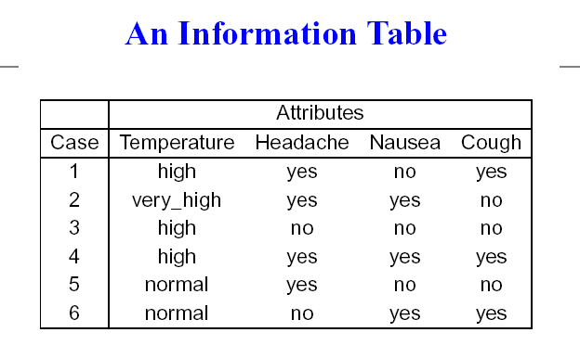

Slide 9
INFORMATION SYSTEM FRAMEWORK
In RS data model information is stored in a table
Each row (tuples) represents a fact or an object
Often the facts are not consistent to each other
A data table is called an Information System

Slide 10
Basic problems in data analysis:
  Characterize set of objects in terms of attribute values
  Reduction of superflous attributes and finding the most significant attributes
  Finding dependency between the attributes
  Removing Inconsistency in Data
  Decision rule generation for Classification
  Rough Set Theory offers simple algorithms
  to answer these questions

Slide 11
Represent concepts as information Granules containing objects
RST measures vagueness in terms of boundary region
No prior information is required
RS is a formal approximation of Crisp Set
Handle inconsistency in data by dividing the set into two consistent sets

Slide 12
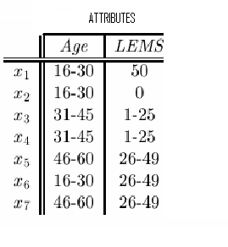
AN INFORMATION TABLE

Slide 13

INFORMATION FUNCTION
I = (U, A); an information system
U is a nonempty set of finite objects
A is a nonempty finite set of attributes
A value V_{a} is assigned to each attribute a;
where a ∈ A and v ∈ V_{a}
ρ : U × A → V_{a} an Information function

Slide 14
ρ (1, Temperature) = high
t = (a, v) an attribute-value pair
[t], is a set of U for which a has value v
[1, 3, 4] = (Temperature, high)
[3, 6] = (Headache, no)

Slide 15
INFORMATION GRANULES
Let x ∈ U and B ⊆ A
An elementary set of B containing x
[x]_{B} = ∩{[(a, v)]⏐a ∈ B, ρ (x, a) = v} is Information Granules
Elementary Sets of Singletons {a}
[1]_{{Temperature}}= [3]_{{Temperature}}= [4]_{{Temperature}}
{1, 3, 4}
[5]_{{Temperature}}= [6]_{{Temperature}}
{5, 6}

Slide 16
Elementary Sets of Subsets of A
[1]_{{Temperature, Headache}} = [4]_{{Temperature, Headache}} =
[(Temperature, high)] ∩ [(Headache, yes)] = {1, 4}
[2]_{{Temperature, Headache}} =
[(Temperature, very_high)] ∩ [(Headache, yes)] = {2}
[3]_{{Temperature, Headache}} =
[(Temperature, high)] ∩ [(Headache, no)] = {3}
[5]_{{Temperature, Headache}} =
[(Temperature, normal)] ∩ [(Headache, yes)] = {5}
[6]_{{Temperature, Headache}} =
[(Temperature, normal)] ∩ [(Headache, no)] = {6}

Slide 17
INDISCERNIBILITY RELATION
One representative object for different attribute set, called indiscernible tuples
Two tuples are indiscernible with respect to a set of attributes B ⊆ A; if a(x)=a(x′) ; ∀a ∈ B
IND_{A}(B); the B-indiscernibility relation
{(x, x′)∈U²⏐∀a ∈ B, a(x) = a(x′)}

Slide 18
IND(Temperature) = {{1,3,4},{2},{5,6}} and
IND(Temperature, Headache) =
{{1,4},{2},{3},{5},{6}}

Slide 19


Slide 20
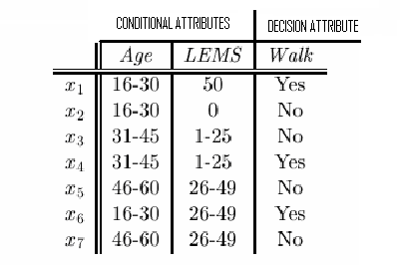
CONCEPT
An elementary set of {Decision} is called a concept
Concepts have the same decision attribute value
{x₁, x₄, x₆}; “Walk” is yes and {x₂, x₃, x₅, x₇}; “Walk” is No
A DECISION TABLE

Slide 21
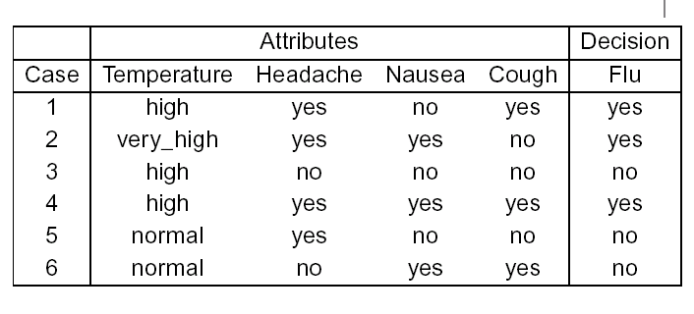

A DECISION TABLE

Slide 22
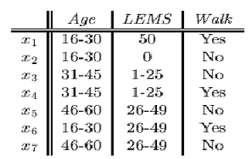
AN INCONSISTENT DECISION TABLE
concept cannot be defined in a crisp manner
Decision attribute “walk” for objects x₃ and x₄
Target set X = {x₃, x₄}cannot be expressed Exactly
Notion of Rough Set emerges

Slide 23
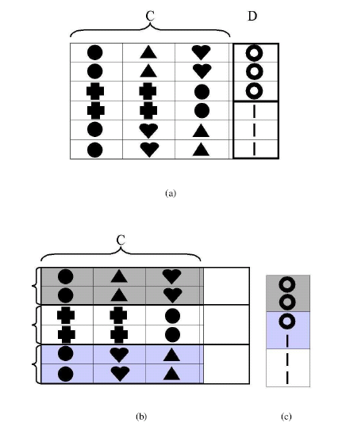

Slide 24
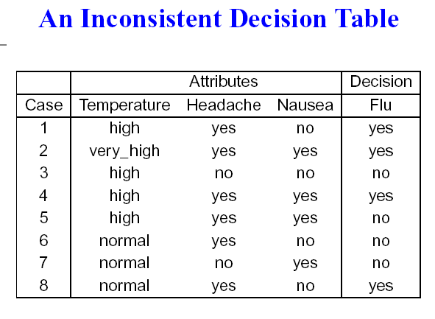
X = {4, 5} cannot be defined exactly, for decision attribute “FLU”

Slide 25
SET APPROXIMATION
X can be approximated by B-lower (BX) and B-upper (BX) approximations
BX={x∈U | [x]_{B} ⊆ X } and B X={x∈U | [x]_{B} ∩X≠∅}
The lower approximation positively (i.e., unambiguously) classified objects belong to X
The upper approximation possibly classified objects as members of X

Slide 26
ROUGH SET
Objects of B-Boundary Region of X:
BN_{B}(X) = BX – BX, cannot decisively classify into X
Objects of negative region of X: (U – BX),
definitely ruled out as members of X
The set X is Rough (inexact) w.r.t. B if BN_{B}(X) ≠ ∅
BN_{B}(X) = ∅, then the set X is crisp (exact) w.r.t. B
< BX, BX > is called a Rough set

Slide 27
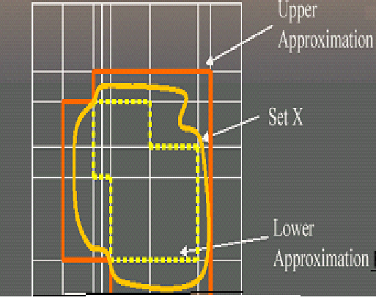
Information Granule

Slide 28
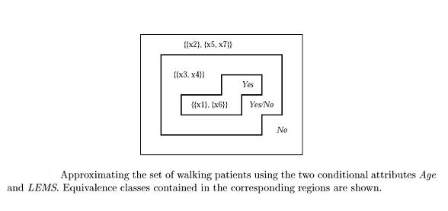
W={x⏐Walk(x)=yes};AW={x₁,x₆};AW={x₁,x₃,x₄,x₆}
Walk is Rough since the Boundary Region is Nonempty

Slide 29
PROPERTIES OF APPROXIMATIONS
B(X) ⊆ X ⊆ B(X)
B(∅) = B(∅) = ∅; B(U) = B(U) = U
B(X∪Y) = B(X) ∪ B(Y)
B(X∩Y) = B(X) ∩ B(Y); B(X∪Y) ⊇ B(X) ∪ B(Y)
B(-X) = -B(X); B(-X) = - B(X); where –X denotes U-X

Slide 30
CATEGORIES OF VAGUENESS
B(X) ≠ ∅ and B(X) ≠ U iff X is roughly B-defineable:
  Able to decide for some elements of U belong to X or –X, using B
B(X)=∅ and B(X)≠U iff X is internally B-indefineable
  Able to decide for some elements of U belong to -X but unable to decide for any element of U, whether it belongs to X or not, using B

Slide 31
B(X) ≠ ∅ and B(X)=U, iff X is externally B-defineable
  Able to decide for some elements of U belong to X but unable to decide for any element of U, whether it belongs to -X or not, using B
B(X)=∅ and B(X) = U iff X is totally B-indefineable
  Unable to decide for any element of U belong to X or –X, using B

Slide 32
IND(Temperature, Headache, Nausea) = {{1},{2},{3},{4,5},{6,8},{7}}
IND(Flu) = {Yes}, {No} = {{1, 2, 4, 8}, {3, 5, 6,7 }}
A{1, 2, 4, 8} = {1, 2}≠∅
A{3, 5, 6, 7} = {3, 7}≠∅
A{1,2,4,8} = {1,2,4,5,6,8} ≠ U
A{3,5,6,7}={3, 4, 5, 6, 7, 8}≠U
So concept “flu” is roughly B-defineable

Slide 33
Rules induced from the Lower Approximation of the concept are called certain
(Temperature, high) & (Headache, yes) & (Nausea, no) → (Flu, yes)
(Temperature, high) & (Headache, no) & (Nausea, no) → (Flu, no)

Slide 34
ACCURACY MEASUREMENT
RS can be characterized numerically by measuring accuracy of approximation of the target set: α_{B}(X) = ⏐BX ⏐ / ⏐BX ⏐; 0 ≤ α_{B}(X) ≤ 1
α_{B}(X)=1, the upper and lower approximations are equal and X is crisp w.r.t. B (X is precise)
α_{B}(X) < 1, X is Rough w.r.t. B (X is vague)
If lower approximation is empty, the accuracy is zero

Slide 35
ROUGH SET and MEMBERSHIP FUNCTION
| X ∩ B(x) |
μ_{X}^{B}(x) = ; μ_{X}^{B}(x) ∈ [0, 1]
| B(x) |
Interpreted as a degree of certainty to which x belongs to X
B( X)={x∈U: μ_{X}^{B}(x) = 1}, B(X)={x∈U: μ_{X}^{B}(x) > 1}
BN_{B}(X) = {x ∈ U: 0 <μ_{X}^{B}(x) < 1},

Slide 36
PROPERTIES of ROUGH MEMBERSHIP FUNCTION
μ_{X}^{B}(x) = 0 iff x∈- B(X)
μ^{B}_{X∪Y} (x) ≥ max (μ_{X}^{B}(x), μ_{Y}^{B}(x)) for any x∈U
μ^{B}_{X∩Y} (x) ≤ min (μ_{X}^{B}(x), μ_{Y}^{B}(x)) for any x∈U
Difference between fuzzy and rough membership

Slide 37
Rough membership can be regarded as a generalization of fuzzy membership
Connection between vagueness and uncertainty
Vagueness is related to sets
Uncertainty is related to elements of sets
Rough set approach shows connection between these two concepts

Slide 38
REDUCT and CORE
A subset of attributes can fully characterize the knowledge in the database, is called a Reduct
[x]_{RED} = [x]_{A} ; the equivalence classes induced by RED attribute set is same that of full attribute set A
Attribute a is dispensible, if IND(A-{a}) = IND(A); otherwise a is indispensible

Slide 39
No attribute can be removed from set RED without changing the equivalence classes [x]_{A}
The reduct of an information system is not unique
Finding a minimal reduct is NP hard problem
The set of attributes common to all reducts is called the core

Slide 40
subset B of the attribute set A is a Reduct if and only if
IND(B) = IND(A) and IND(B-{a}) ≠ IND(A) for all a ∈ B
IND(A) = {{1},{2},{3},{4},{5},{6}}
IND(Temperature) =
{{1,3,4},{2},{5,6}} ≠ IND(A)
IND(Temperature, Headache)=
{{1,4},{2},{3},{5},{6}}≠IND(A)
{Temperature}, {Temperature, Headache} are not Reducts

Slide 41
IND(Temperature, Headache, Nausea) = IND(A),
IND(Temperature, Nausea, Cough) = IND(A),
IND(Headache, Nausea, Cough) = IND(A)
Therefore, Reducts are:
{Temperature, Headache, Nausea},
{Temperature, Nausea, Cough} and
{Headache, Nausea, Cough}

Slide 42
FEATURE SELECTION
Evaluate all Reducts and take intersection of them i.e. core
Keep only the Reducts which appear sufficiently often, called approximate Reducts
Distinguish between useless and useful attributes
In reality every attribute is more or less useful, therefore, quantify the attributes

Slide 43
Evaluate how much decision attributes depend on condition ones
Remove one attribute and evaluate again the dependency
The more important the attribute is, more the dependency value decreases
Difference of dependency, determines utility of the attributes

Slide 44
ATTRIBUTE DEPENDENCY
What degree of dependency exist between two (disjoint) sets of attributes, B (conditional) and D (decision)?
The dependency is defined:
Σ_{X∈INDD(U)}⏐BX⏐ ⏐ POS_{B}(D) ⏐
γ(B,D) = =
⏐U⏐ ⏐U⏐

Slide 45
If γ(B,D) = 1, implies the attributes in B can precisely define the partition IND_{D}(U)
If we cannot precisely decide about the membership of any object, that is BX= ϕ, γ(B,D) = 0.
If γ(B,D)<1, then D depends on B by a degree γ(B,D); (0≤ γ(B,D) ≤1)

Slide 46
Compute how much removing an attribute changes the original dependency:
γ(B,D) - γ(B-{a}, D)
σ_{B,D} (a) =
γ(B,D)
If γ(B,D) = γ(B-{a}, D) and σ_{B,D}(a) = 0
Then (B-{a}) is a reduct
The attribute a is not significant at all and so we don’t consider it as a useful attribute.

Slide 47
If B is a reduct, some of its attributes are less useful than others, because they allow to distinguish between a few small cases
A Reduct is transformed into a decision rule
(B ⇒_{k} D);
Input attributes is used to derive specific knowledge of the output

Slide 48
CLASSIFICATION

Slide 49
Reduct
An attribute reduct is a minimal subset of attributes that provides the same descriptive ability as the entire set of attributes.
In other words, attributes in a reduct is jointly sufficient and individually necessary.
We obtain the same results and conclusions by using a smaller set of attributes. As a consequence, we normally obtain more general and simpler rules.

Slide 50
Classification is the original goal of RST
Information table is Consistent or Inconsistent
Calculate the Reducts of the table and extract the Rules
If (Temperature is HIGH) And (Headache is YES) and (Nausea is NO) Then (Disease is Flu)

Slide 51
THE DISCERNIBILITY MATRIX
The physical meaning of the matrix element A(x_{i}, x_{j}) is that objects x_{i} and x_{j} can be distinguished by any attribute in
A(x_{i}, x_{j}).
The pair A(x_{i}, x_{j}) can be discerned if A(x_{i}, x_{j}) ≠ ∅.
A discernibility matrix A is symmetric, i.e., A(x_{i}, x_{j}) = A(x_{j}, x_{i}) and A(x_{i}, x_{i}) = ∅.
Sufficient to consider only the lower triangle or the upper triangle of the matrix.

Slide 52
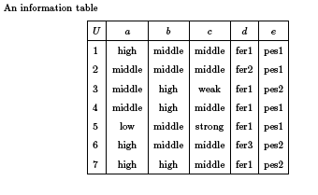
Object 1 and 2 are discerned by attribute a or d

Slide 53
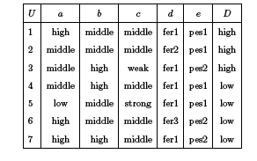
A Decision Table

Slide 54
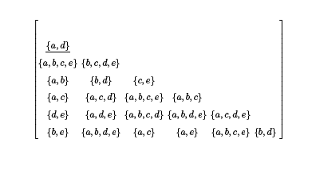

Slide 55
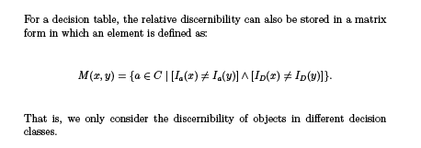
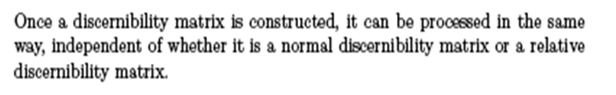
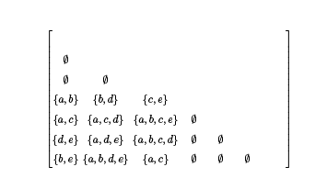

Slide 56
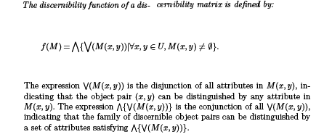
The Discernibility Function

Slide 57

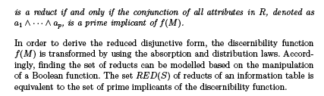

Slide 58
Distributive Law – This law permits the multiplying or factoring out of an expression.
  A(B + C) = A.B + A.C (OR Distributive Law)
  A + (B.C) = (A + B).(A + C) (AND Distributive Law)
Absorptive Law – This law enables a reduction in a complicated expression to a simpler one by absorbing like terms.
  A + (A.B) = A (OR Absorption Law)
  A(A + B) = A (AND Absorption Law)

Slide 59
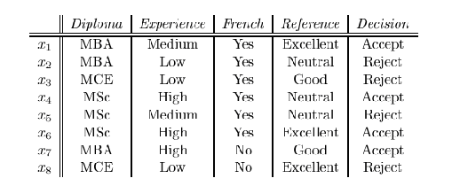
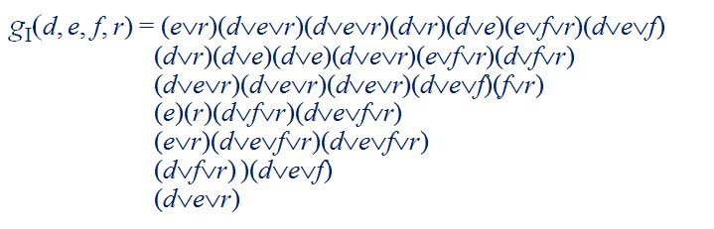
After simplification the function g_{I} (d, e, f, r ) = e ∧ r

Slide 60
RULE EXTRACTION
Find the minimal set of consistent rules that characterize the system
For a set of condition attributes {A₁, A₂, …, A_{n}} and a decision attribute Q, the rules should have the form
(A_{i}=a) ∧ (A_{j}=b) ∧ …….. ∧ (A_{k}=c) → (Q=d)
This is typical form of Association Rule

Slide 61
MULTIPLE CLASSIFIER
Three classes of knowledge in an Information System:-
Indispensable knowledge in core; useful but not necessary attributes constitute the reduct together with core and others are irrelevant
Existence of multiple reducts represent the Information system in alternative ways

Slide 62
Rough set approaches yield subspaces of classification
In practices multiple kinds of classifiers to obtain the diversity of decisions from different classifiers
Ensemble of Classifiers
A multiple classifier system, lead to improvement of classification in terms of both accuracy and stability

Slide 63
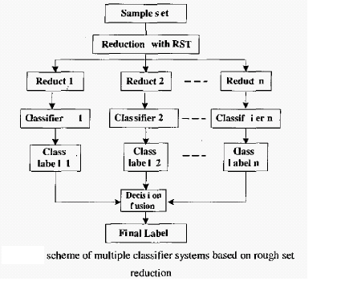
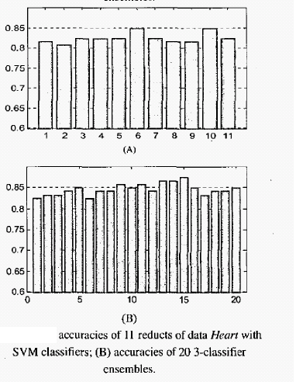

Slide 64
APPLICATIONS
Dimensionality Reduction
FEATURE SELECTION
Discernibility function based and attribute dependency based
Rough set theory for Classification
E-MAILS CLASSIFICATION
Rough set based model classify the emails into three categories - non-spam, spam and suspicious
positive region, negative region and boundary region, respectively
classification reduce the error rate so that a non-spam is classified as a spam.

Slide 65
CONCLUSIONS
The Rough Set theory is a viable approach for extraction of meaningful knowledge and making predictions for an individual data object, rather than a population of objects
Combining Rough Set Theory and Fuzzy set Theory together serve both theoretical and practical purpose for handling uncertainty

Slide 66
Further Research
Rough Logic based on the concept of Rough Truth value
Theory of Rough Relation and Rough function
Comparison with many other data analysis approaches, like Neural Network, Regression Analysis, genetic algorithms

Slide 67
Thank you

